Slide 1
Office of Refugee Resettlement Services for Survivors of Torture Program Data Points Optional Tracking Tool Training
Sydney Briggs and Sarah Catherine Williams
April 25, 2023
Notes:
Hi and welcome to the Program Data Points Optional Tracking Tool Training. My name is Sydney Briggs and I’m a Research Scientist at Child Trends. I’m part of a team that has been working with the Office of Refugee Resettlement on building evidence capacity and one of our products has been a tool to support Services for Survivors of Torture grantees in recording and calculating the required Program Data Points.

Slide 2
Contents
Purpose of the Optional PDP Tracking Tool
Navigation
Client data entry tab
Summarized client data tabs
Training data entry tab
Pro bono data entry tab
Summarized training and pro bono data tabs
Notes:
During this presentation I’ll talk a little more about the purpose of the tracking tool, how to navigate it, how to enter different types of data in it, and how to view summary data ready to enter into RADS.

Slide 3
Welcome to the SOT Grantee Optional PDP Tracking Tool Training
The purpose of this presentation is to orient grantees to the functions and use of the tracking tool.
This tool can help tracking and calculating the Program Data Points that are reported annually in RADS.
If you already automate this process or are satisfied with how you calculate the PDPs, there is no requirement to use this tool.
The first tab in the Excel workbook has an overview as well as instructions for completing each field.
This tool is designed to be used for the 5 years of the current grant period.
Notes:
The PDP Tracking Tool is designed to be place where you can enter the required information about each client as they participate in your program, and automatically have that information summarized for reporting in RADS. You can also record information on training attendees and pro bono hours that get reported as well. The way the Excel workbook is set up, you can keep using the same data entry tabs throughout the 5 years of the grant, but you’ll have separate summary tabs with everything you need for reporting the PDPs for each individual year. This is absolutely optional though. If you already have a system going for calculating your PDPs and this doesn’t feel like it would help you, there’s absolutely no requirement to use.

Slide 4
Navigation
Access the different sheets of the workbook by using the colored tabs listed horizontally across the bottom of the page.
There are 3 data entry tabs (green) where you will record information and 6 summary tabs (multiple colors) that aggregate information entered in the data entry tabs.
Notes:
To navigate through the different sheets in the workbook, you’ll use the colored tabs along the bottom of the page. There are 3 green tabs where you’ll enter all of your data, and then 6 summary tabs where’ll you see the aggregated information for each grant year.

Slide 5
Navigation
The second tab, “DP1-17, 20-26 Client Data Entry” is where you will enter all client information necessary to calculate the totals for each data point.
Next, we’ll walk through each of the data points in the Client Data Entry tab.
Notes:
The tab where you’ll spend most of your time is the one after the instructions called, “DP 1-17, 20-26 Client Data Entry,” because that’s where all your client information will go.

Slide 6
Client Data Entry
The top row in this tab has the number associated with each PDP.
The second row contains the heading for data points that span multiple columns.
The third row describes the information that should be entered in each column.
Data entry begins in the fourth row.
Notes:
When you first click on the Client Data Entry tab, you’ll see a fairly empty spreadsheet with some headings in the first 3 rows, containing the number of each data point, and the data point names, prompts, and descriptions of required information. You’ll start entering information in row 4.

Slide 7
Client Name or ID
Begin by entering a client name or program ID number in column A.
This is for your tracking purposes and will not to reported in RADS.
Notes:
Column A asks for a client name or ID. This does not get reported in RADS, so you can use the identifier that’s most helpful for your tracking purposes.

Slide 8
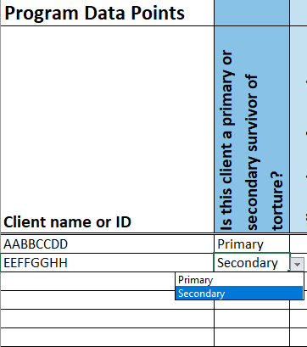
DP1a. Primary or Secondary Survivor
Use the dropdown menu in column B to indicate whether the client is a primary or secondary survivor.
Only the words “Primary” and “Secondary” can be entered in this column.
Notes:
Next, in Column B, there will be a dropdown menu that you’ll use to select whether each client is a primary or secondary survivor. No other values can be entered into this column.

Slide 9
DP 1a-1b. Client Dates of Entry and Exit
In column C, record the date the client entered the program in the format MM/DD/YYYY.
This date is important for calculating which grant years the tracker should include a client in.
When a client exits the program, record that information in column AM. Otherwise, leave this cell blank.
Notes:
In Column C, put the date that the client entered the program. This needs to be in the month/day/year format indicated, and it’s an important piece of information for making sure the tracker includes a client in calculations for the correct years. In the next column, enter the date when the client leaves the program. You’ll see that here we jumped from Column C to Column AM, and that’s just because we have some hidden columns with formulas in between those two.

Slide 10
DP2. Client Age when First Subjected to Torture
In column AS, enter the client’s age when first subjected to torture.
Enter an age in digits, do not enter an age range.
If you are unsure, please provide your best guesstimate.
This data point is only required for primary survivors. It will appear blocked out in rows where the client is listed as a secondary survivor.
Notes:
In the following column, which is now AS, you’ll enter the client’s age when first subjected to torture. This data point is only collected for primary survivors, so if you previously indicated that a client was a secondary survivor, the corresponding cell will appear blocked out so that you don’t enter information there.

Slide 11
DP3. Type of Torture Suffered
Use the dropdown menus in columns AT-AX to enter the type(s) of torture suffered by the client.
The options listed are broad categories that contain multiple sub-categories and are defined in the User Guide.
There are five columns available here, but you do not need to complete all of them for every client.
This information is only collected for primary survivors and cells will be blocked out for secondary survivors.
Notes:
The next data point is type of torture suffered, where you’ll use the dropdown menus to select the categories that best capture each client’s experience. This is the same list that appears on the PDP reporting form and these are designed to be broad categories that include multiple sub-categories. For any questions about what’s contained within a category, please consult the PDP User Guide provided by ORR. You have the ability to select five types of torture here, but you do not need to complete all of them for every client. And, as you can see on the slide, this is another data point that will appear blocked out for secondary survivors.

Slide 12
DP3. Type of Torture Suffered
This data point includes an “other” option to capture types of torture not contained in the list.
If you select “other,” a light blue highlight will appear in column BN, “If other, please specify.” Enter the type of torture here.
Review the definitions in the User Guide before selecting “other” to check whether a type of torture is included in the existing categories.
Notes:
In addition to the list of categories under “types of torture suffered,” you do also have the option to select “other” if a client’s experience cannot be classified as one of the categories provided. If you select “other,” the corresponding cell in the column “If other, please specify” will highlight in light blue to remind you to enter the type of torture in that cell. However, you are encouraged to review the definitions in the User Guide before making use of the write-in option.

Slide 13
DP 4. Reasons for Torture
ORR provides eight potential reasons for torture. Use the dropdown menus in columns BO-BW to select “Yes” or “No” for each one.
If a client’s reason for torture is not listed, select “Yes” under “Other” in column BX and complete column BY, “If other, please specify.”
This data point is collected for primary survivors only.
Notes:
Starting in Column BO, there are 8 potential reasons for torture, and you’ll use the Yes/No dropdown menu in each one to indicate where it applies for each client. If multiple reasons apply to a client, you can select Yes multiple times. If none of the reasons given apply to a client, select No for all of them, then select Yes under “Other” in Column BX and write in the reason in column BY, where you’re asked to specify. This information is only collected for primary survivors. However, please consult the User Guide before selecting “other” to ensure that a client’s reason for torture doesn’t fall under one of the existing definitions.

Slide 14
DP5. Country where Torture Occurred
Use the dropdown menu in column BZ to select the country where torture occurred.
If torture also occurred in a second country, select that country in column CA, “Additional country where torture occurred.”
This data point is collected for primary survivors only.
Notes:
The next data point is country where torture occurred. In Column BZ there’s dropdown with a long list of countries for you to select from. If a client experienced torture in a second country, you can select a second response in column CA, marked “additional country where torture occurred.” This information is only collected for primary survivors. The list of countries is also included in the User Guide and you wish to consult it there to see the full list.

Slide 15
DP6. Client Goals at Intake
ORR tracks six categories of client goals at intake. Select “Yes” or “No” from the dropdown menus under the goals in columns CB-CG to indicate whether the client had a goal in each category.
This data point is collected for primary and secondary survivors.
Notes:
Then, starting in Column CB you’ll report on the 6 client goals that ORR tracks. You’ll use the yes/no dropdown menus in each column to indicate whether each client had goals in each of the 6 categories at their intake into the program.

Slide 16
DP7. Client Gender
Use the dropdown menu in column CH to select the client’s gender.
In addition to “Female” and “Male,” there is a third gender option, “X,” for clients who identify outside of the gender binary.
This data point is collected for primary and secondary survivors.
Notes:
The next data point is in column CH, and you just need to select the client’s gender identity. There are 3 options – female, male, and “X” for unspecified or another gender.

Slide 17
DP8. Immigration Status at Intake
Use the dropdown menu in column CI to indicate the client’s immigration status at the time of intake.
For Legal Permanent Residents and U.S. citizens, there are multiple options based on prior status.
This data point includes the response option “Other at intake.” If you select this option, complete the pale blue highlighted cell in column CL, “If other, please specify.”
This data point is collected for primary and secondary survivors.
Notes:
Afterwards you’ll indicate the client’s immigration status at intake using the dropdown menu. Note that for legal permanent residents and US citizens there are multiple options based on the client’s prior immigration status. There’s also an “other at intake” option here, and if you select that, you’ll need to specify that client’s status in the following column.

Slide 18
DP9. Age at Intake
Enter the client’s age at intake in column CM.
Enter digits; do not enter an age range.
If you are unsure of their age, please provide your best guesstimate.
Some data points are only applicable for clients that were under the age of 18 at intake. The tracker will block out the cells for those data points if the client was younger than 18 at intake.
This data point is collected for primary and secondary survivors.
Notes:
From there, you’ll enter the client’s age at intake using digits. After you enter the age, you’ll see some columns get blocked out for clients under the age of 18, because those data points are only collected for clients 18 and older at intake.

Slide 19
DP10. Years of Education Prior to Arrival
Enter the number of years of education prior to arrival in the U.S. in column CN.
Use digits to enter the number of years. Do not enter words or ranges. Use decimals for partial years.
If you are unsure, please provide your best guesstimate.
This data point is collected for primary and secondary survivors who are 18 or older at intake.
Notes:
This includes years of education prior to arrival in the US. So, for adult-aged clients, use digits to enter their years of education. You can use decimals for partial years, but don’t enter months or fractions.

Slide 20
DP11. Employment Status at Intake
Use the dropdown menu in column CO to select the client’s employment status at intake.
This data point is collected for primary and secondary survivors who are 18 or older at intake.
Notes:
The next data point is also for clients ages 18 and older only. You’ll use the dropdown to select the appropriate employment status at the time of intake.

Slide 21
DP12. Length of Time in U.S. at Intake
Use the dropdown menu in column CP to select approximately how long the client had been in the U.S. at intake.
If you or the client are not sure or do not know, select “Unknown.”
This data point is collected for primary and secondary survivors.
Notes:
In column CP, you’ll use the dropdown menu to select approximately how long the client had been in the US at intake – less than 1 year, 1 to 5 years, or longer that 5 years. If this information is unknown, you can select the “unknown” option here.

Slide 22
DP13. Country of Origin
Use the dropdown menu in column CQ to select the client’s country of origin.
This is a long list. To see the full list on one page, consult the User Guide.
This data point is collected for primary and secondary survivors.
Notes:
Next is country of origin in column CQ. This is a long dropdown list, so if you’d like to see it all in one place, you can consult the User Guide .

Slide 23
DP14. Ethnicity
Use the dropdown menu in column CR to select the client’s ethnicity.
If the client’s ethnicity is not listed, select “Other” and complete column CS, “If other, please specify.”
This is a long list. To see the full list on one page, consult the User Guide.
This data point is collected for primary and secondary survivors.
Notes:
In column CR, you’ll indicate the client’s ethnicity. Again, this is a long dropdown list, so if you’d like to see it all in one place, you can consult the User Guide . The User Guide may also be helpful for seeing if your client’s ethnicity is listed with an alternate spelling or grouping. At the end of the list there are options for “other,” if the client’s ethnicity isn’t listed, and “unknown” if it’s unknown. If you select “other ,” please write in the client’s ethnicity in column CS.

Slide 24
DP15. Religion
Use the dropdown menu in column CT to select the client’s religion.
If the client’s religion is not listed, select “Other” and complete column CU, “If other, please specify.”
This data point is collected for primary and secondary survivors.
Notes:
Column CT asks for the client’s religion. Note that each of the religions listed in the dropdown is broad and contains many different denominations. There are also options for “none,” “other,” and “unknown,” and space to specify “other” in column CU.

Slide 25
DP16. Primary Language Used
Use the dropdown menu in column CV to select the primary language staff or interpreters use to communicate with the client.
If the client’s language is not listed, select “Other” and complete column CW, “If other, please specify.”
This is a long list. To see the full list on one page, consult the User Guide.
This data point is collected for primary and secondary survivors.
Notes:
Next you’ll indicate the primary language that staff and interpreters use to communicate with each client. This is in column CV. If the primary language is not listed, please select other and specify in column CW.

Slide 26
DP17. Clients Served by Service Category
ORR tracks six categories of services. Select “Yes” or “No” from the dropdown menu under each goal to indicate whether a client received services in each category.
This data point is collected for primary and secondary survivors.
Clients are considered “active” and included in summary calculations if they received at least one type of service in a grant year.
Notes:
The following data point is services received and here you’ll see the 6 service categories that ORR tracks, each with a Yes/No drop down to indicate whether a client received services in each category in a given grant year. This data point is particularly important because it’s used to determine whether or not a client is “active” in each grant year, which is one of the parameters for whether clients are included in different calculations.

Slide 27
DP17. Clients Served by Service Category
Up to this point in the tracker, data points are only entered once for each client. However, services received are entered for each grant year.
Each grant year, before submitting your data to RADS, update the tracker to indicate which types services each active client received during that year.
Some rows will be blocked out for different grant years depending on when a client entered or exited the program.
Notes:
Services received is set up a little differently from the other data points. This is the first data point you’re encountering that is entered once per grant year, as opposed just once per client, because if a client is in the program for more than one grant year, you’ll need to report on the services they received in each grant year. Depending on when a client enters and exits the program, you’ll see these columns blocked out for different years.

Slide 28
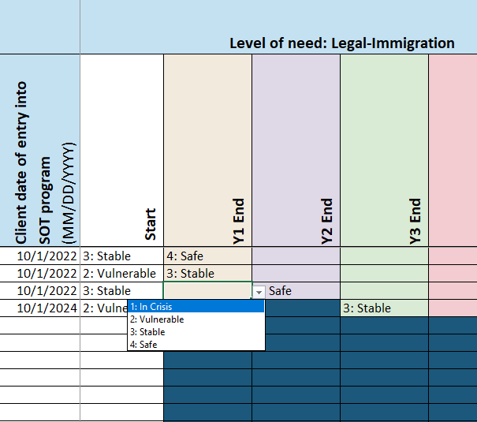
DP 20-26. Outcome Indicators
ORR tracks six outcome indicators for clients. For each client, select their level of need at “Start” and then their level of need at the end of the first grant year they were in the program.
For subsequent years, the client’s level of need at the end of the prior grant year serves as the start point for the following year.
Notes:
The final set of client data points are the six outcome indicators. For each indicator, you’ll enter the client’s level of need when they started the program, and then again at the end of the first grant year the client is in the program. For each subsequent year that a client is in the program, you only need to enter their level of need at the end of the grant year, because the previous year’s end point will serve as the following year’s start point.

Slide 29
DP 20-26. Outcome Indicators
The six outcome indicators also need to be entered for each grant year, before you submit data in RADS.
Some rows will be blocked out for different grant years depending on when a client entered or exited the program.
Notes:
All 6 outcome indicators need to be completed each year for every active client. However, depending on when a client enters and exits the program, you’ll see these columns blocked out for different years.

Slide 30
Summary Data for Client Data Entry
To see the summary tables for the information entered in the Client Data Entry, scroll across the tabs at the bottom of the page to the tab “Y1 DP 1-19 Summary Data.”
Notes:
Alright, once you’ve made it through all that client data entry you’ll want to see the results! Using the tabs across the bottom of the workbook, move to the brown Year 1 summary data tab.

Slide 31
Overview of Year 1 Summary Data
Notes:
When you open the Year 1 summary data tab, you’ll see a lot of tables that compile the information you entered about your clients. These correspond to the tables you’ll need to complete in RADS. In the following slides we’ll walk through a few key points about the summary tables.

Slide 32
Year 1 Summary Data
The only information you will enter in this tab are the grantee data fields at the top of the worksheet.
Notes:
Firstly, the only information you will enter in this tab are the grantee data fields at the top of the worksheet – program name, grant number, and point of contact – everything else will be filled out automatically.

Slide 33
Year 1 Summary Data
Each data point is summarized here in a format that replicates the SOT Program Data Points Form and mirrors the data entry portal in RADS.
Notes:
Each data point is summarized here in a format that replicates the SOT Program Data Points Form and mirrors the data entry portal in RADS. Here you can see the tables for the first 3 data points.

Slide 34
Year 1 Summary Data
For each data point where the “Other” response option was selected, the write-in answers will be summarized below the table for the data point.
The table will display all write-ins entered in the data entry tab, but will bold and highlight the entries corresponding to the grant year being summarized.
For each grant year, only report the “other” reasons that are bolded and highlighted in this list.
Notes:
All data points that included an “other, please specify” option have an additional table below them where those write-in options will appear. All write-in entries from the column will appear in this table, but you should only report the entries that are bolded, highlighted, and have non-zero counts next to them because those are the entries corresponding to the grant year being reported on.

Slide 35
Year 1 Summary Data
For data points with long lists of response options, the options with non-zero values will be highlighted.
These data points are
DP 5. Country where torture occurred
DP 13. Country of origin
DP 14. Ethnicity
DP 16. Languages used
Notes:
You’ll see that some of the tables in the summary data tabs are very long because they have many, many options to choose from. These are the tables for country where torture occurred, country of origin, ethnicity, and language. To facilitate your data entry into RADS, the response options with non-zero values for the relevant grant year will appear highlighted and bolded. These are the only values you need to enter into RADS.

Slide 36
Summary Data for Other Years
To review the summary data for other grant years, use the tabs along the bottom of the page to navigate to each of the 5 summary data sheets.
Notes:
As years pass and you need to report summary data for years 2 through 5, you can find summary data tabs for additional grant years along the bottom of the workbook.

Slide 37
Summary Data for Other Years
To review the summary data for other grant years, use the tabs along the bottom of the page to navigate to each of the 5 summary data sheets.
Notes:
For example, if you select the Year 2 Summary Data tab.

Slide 38
Overview of Year 2 Summary Data
Notes:
You’ll see a worksheet that’s set up similarly to Year 1, but will only be populated with data for Year 2.

Slide 39
Outcome Indicators Summary Data
After the Year 5 Summary Data tab, there is a tab for the summary data for the outcome indicators across all years, DPs 20 to 26.
Notes:
If you scroll past the tabs for the 5 grants years, you’ll see a dark blue tab named “DP 20-26 Summary Data.”

Slide 40
Outcome Indicators Summary Data
Notes:
Here, you’ll find summary tables for the outcome indicators for all five grant years.

Slide 41
Outcome Indicators Summary Data
The only information you will enter in this tab is the field at the top to indicate the tool used to gather the outcome indicator data.
Notes:
The only information you will enter into this tab is the field at the top to indicate the tool used to gather the outcome indicator data.

Slide 42
Outcome Indicators Summary Data
The matrices on these tabs mirror those provided in the PDP Form and contain all the information that needs to be entered in RADS.
Notes:
Then the matrices on these tabs mirror those provided on the Program Data Points form and contain all the information that needs to be entered into RADS. For each year, you’ll see the six outcome indicators each separated out for new clients and continuing clients.

Slide 43
Training Data Entry Tab
There is a separate tab for recording the number of people trained by profession at each training the program holds.
Notes:
In addition to all the client data you’ll report each year, there are two other types of data you’ll report on. The first of these is training data. To the right of the client data entry tab, there’s a second green tab called DP 18 Training Data Entry.

Slide 44
Training Data Entry Tab
Here, the training name and location are for your own tracking purposes, whereas the training date and number of people trained by profession will be used to calculate the summary data.
Notes:
In this tab, you’ll enter all the trainings conducted during the grant year along with the number of people trained by profession at each one. Here, the training name and location are for your own tracking purposes, whereas the training date and number of people trained by profession will be used to calculate the summary data. If the training attendees belonged to professions other than those provided, enter the number in the “Other” column and enter the appropriate profession in the “If other, please specify” column to the right.

Slide 45
Pro Bono Hours Data Entry
There is also a tab for recording the hours contributed by pro bono services.
Notes:
The last set of data you need to report on each year are the hours contributed by pro bono services. This information will go in the third green tab, located to the right of the training data entry tab.

Slide 46
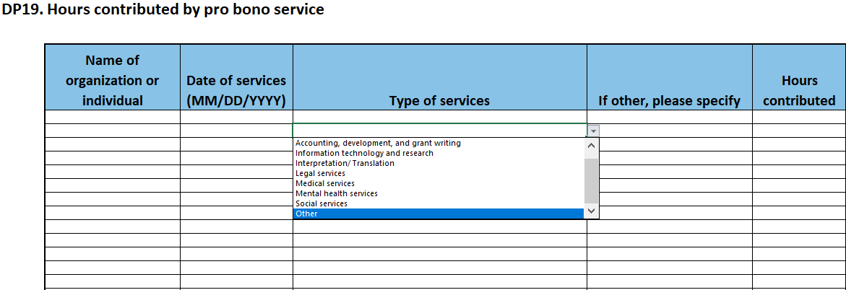
Pro Bono Hours Data Entry
Enter the organization name (for your own tracking purposes), the date of service provided, select the type of services from the dropdown menu, and enter the hours contributed.
Notes:
In the Pro Bono Hours Data Entry tab you’ll enter the organization name (for your own tracking purposes), the date of service provided, select the type of services from the dropdown menu, and enter the hours contributed. If the services provided don’t belong in any of the existing categories, please select “Other” and enter the services in the “If other, please specify” column to the right.

Slide 47
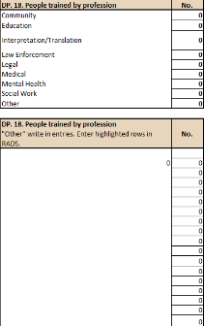
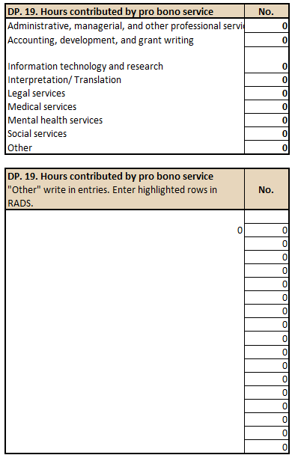
Training and Pro Bono Hours Summary Data
Summary data for people trained and pro bono hours contributed will appear in the summary data tabs for each year, alongside the summarized client data.
Notes:
Both training and pro bono hours summary data will appear in the same summary data tabs as the client data.

Slide 48
Questions?
For any questions related to the Program Data Points optional tracking tool, please contact the Program Officer for the Services for Survivors of Torture Program with any questions.
Notes:
Finally, if you have any questions or challenges as you’re setting up or using this tracker, please reach out to the Program Officer for the Services for Survivors of Torture program for assistance. Thank you.

